Slide 1

The State of Division Report
October 2014

Slide 2
School Division Highlight from 2013-2014
84 students earned awards at the Piedmont Regional Science Fair, including both Best in Show awards and 75 percent of all first-place awards;
Destination Imagination teams
  Albemarle High School and Brownsville Elementary were among the top five in the world in their competitive category.
  Cale Elementary also finished in the top ten in the world in their category
The Environmental Studies Academy began operation at Western Albemarle High School.
High school athletes won 6 state championships and 4 student athletes won individual state titles;
8 students were selected for the Summer Residential Governor’s School in agriculture, engineering, the humanities , music and technology
1200 students participated in the division’s 21st annual visual arts festival

Slide 3
Albemarle County Public School Grants Received
Club Yancey received a $142,000 state grant with the potential of receiving a total of $426,000 over three years.
$46,000 to Murray High School and the Community Public Charter School to advance project-based learning,
$40,000 from the Lastinger Family Foundation to Woodbrook Elementary School for an outdoor environmental classroom;
$20,000 from Battelle to support the division’s manufacturing lab schools;
$17,000 from the Shannon Foundation to support innovative learning projects at eight schools;
$10,000 from Verizon for the Environmental Studies Academy;

Slide 4
High School Highlights
Our Strategic Goal in Action

Slide 5
On Time Graduation Continues to Increase

Slide 6
High School Drop-Out Rate Continues to Decline

Slide 7
High School Graduation Rates
Notes:
Break slide up in all and everyone

Slide 8
SAT Scores
Verbal
Math

Slide 9
Advanced Placement and Dual Enrollments

Slide 10
Advance Placement Score Distribution

Slide 11
Middle School Highlights

Slide 12
Elementary School Highlights

Slide 13

Fine Arts

Slide 14
Fine Arts
High School Enrollments
Performances

Slide 15

Career and Technical Education

Slide 16
Secondary Enrollments in Career and Technical Courses

Slide 17
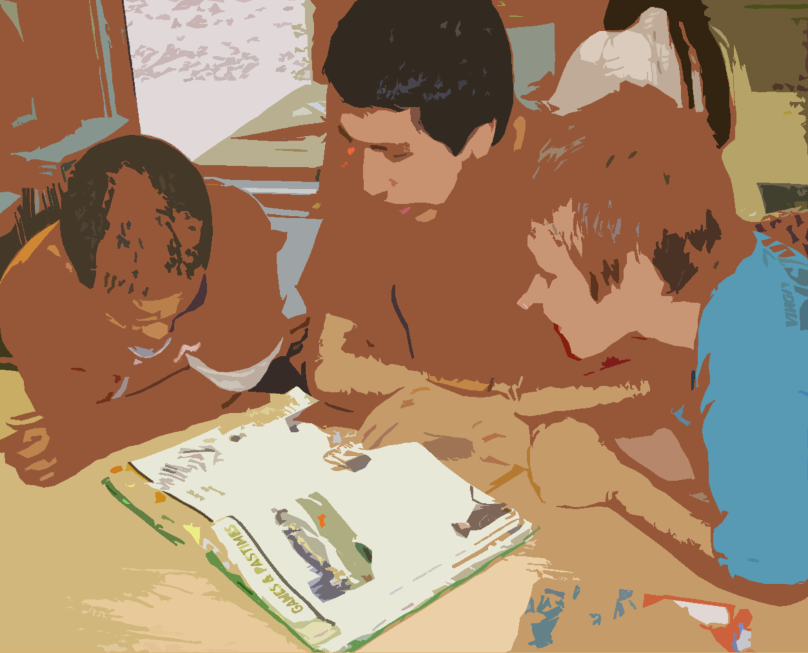
Gifted Education

Slide 18
Opportunities Offered and Supported
Animation Projects
Book Groups and Clubs
Coding Projects
Chess Clubs
Destination Imagination Teams
Design Challenges
Digital Fabrication Projects
GEMS (Girls Excited about Math and Science)
Geography Bee Competition
Independent Study
Literary Magazines
Maker & Engineering Projects
Math Clubs
Model United Nations (Middle and High School)
National History Day Projects (Middle and High School)
Piedmont Regional Science Fair Projects
Photography Clubs
Poetry Clubs
Robotics
Rocketry
The Stock Market Game Teams
Teen Tech Girls
Virginia Film Festival Projects
Writer’s Cafes
Writer’s Eye
Youth Leadership Initiative Programs

Slide 19

Programs and activities

Slide 20
Student Activities
Division-wide art show for Youth Art Month
Inaugural Summer Fine Arts Academy
Spelling Bee
Writer's Eye
Literacy Explosion
24 Competition
Math Counts
Math Olympiad
Meaningful Watershed Educational Experience (MWEE)

Slide 21
The future of Assessments

Slide 22
College Workforce Readiness Assessment
Administered 2013

Slide 23
2012-2013 College Workforce Readiness Assessment

Slide 24
Performance Assessment Baseline
The Future of Assessment

Slide 25
Progression of CAI Roll-Out
2011 Mapped the assessment to the LLC
2012 Wrote assessment tasks and vertical team piloted in schools
2013 Revised assessment tasks through vertical teams
2014 We scored student work.
2015 School teams will be reporting by student

Slide 26
2013-2014 Performance Task Data

Slide 27
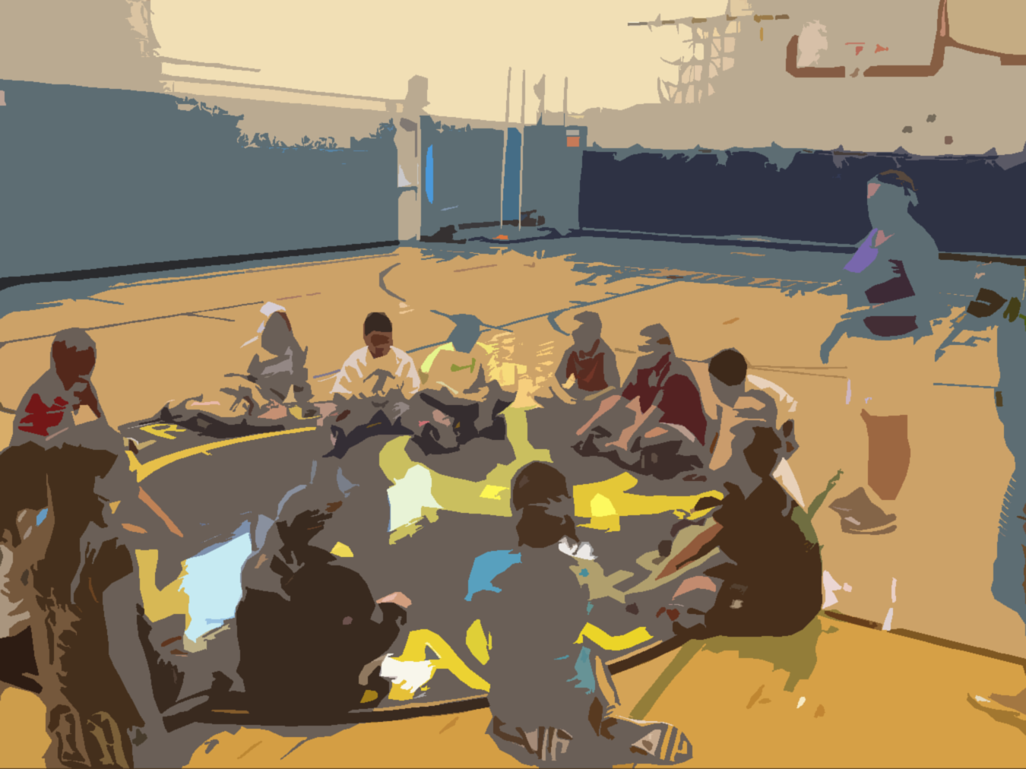
Questions?

